Slide 1
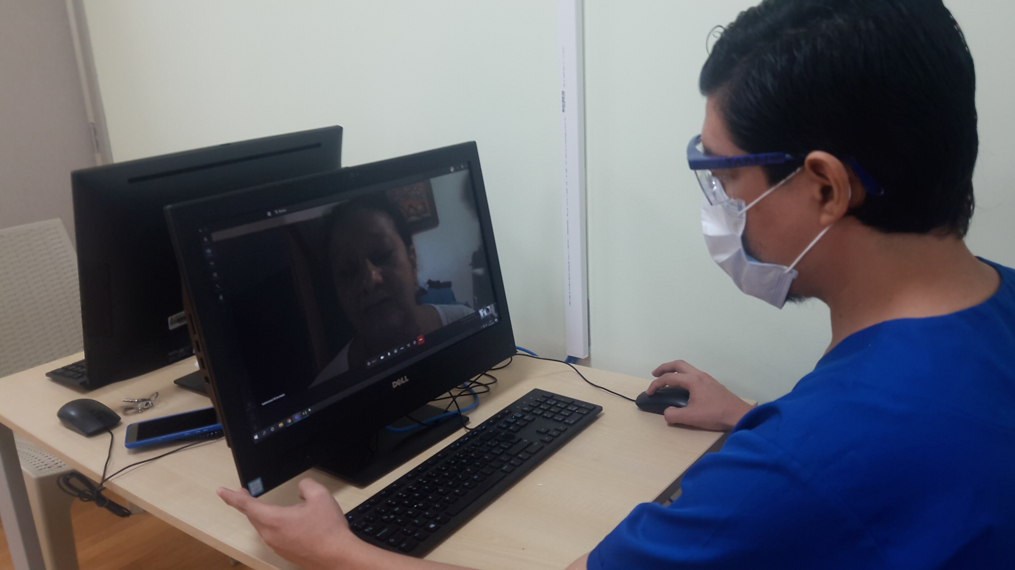
MedicalTV Live
AI + Voice Assistant + IPTV + Cast/Mirror for medical streaming & learning
What it is
A web app that lets clinicians, learners, and families discover trusted video & radio — and control playback hands-free like Alexa.
medicaltv.live
By Doctors Explain (Nairobi, Kenya)
Notes:
[Sources]
- Wikimedia Commons image (CC BY-SA 4.0): https://commons.wikimedia.org/wiki/File:Doctor_attending_by_teleconsultation.jpg
- Product: https://medicaltv.live/
[/Sources]

Slide 2
Problem
MedicalTV Live
Health knowledge is abundant — but not accessible at the moment of need.
For clinicians & learners
For the public
Continuous learning is hard to fit into busy schedules.
Content is scattered across YouTube, radio, PDFs, and social media.
Hands are often occupied (clinics, labs, wards) — search & control is friction.
Misinformation spreads faster than trusted guidance.
Families want simple, language-appropriate explanations.
TV is the biggest screen at home — but discovery is poor.
Kenya physicians per 1,000 people (most recent): ~0.1
Confidential — for discussion
Notes:
[Sources]
- World Bank, Physicians (per 1,000 people) — Kenya: https://data.worldbank.org/indicator/SH.MED.PHYS.ZS?locations=KE
[/Sources]

Slide 3
Solution
MedicalTV Live
MedicalTV Live: streaming + a voice-first assistant for discovery & control
What users can do (examples)
Multi-device by design
“Search YouTube for cardiology lectures” → instant results.
“Play medical radio” or “play first aid” → hands-free playback.
“Open settings / open profile” → fast navigation.
“Add to favorites” and “get recommendations” → personalized feed.
Cast / Mirror
Voice remote
Confidential — for discussion
Notes:
[Sources]
- Product feature overview & assistant: https://medicaltv.live/
- Virtual Remote: https://medicaltv.live/remote-control/
- Cast & Mirror: https://medicaltv.live/cast-mirror/
- Voice assistant demo (Leo): https://www.facebook.com/drlevicheruocheptora/videos/1555733615445158/
[/Sources]

Slide 4


IPTV Backbone
MedicalTV Live
Internet-delivered TV makes MedicalTV scalable, interactive, and TV-first.
What IPTV is
What it enables for MedicalTV
TV delivered over the internet (IP), not cable/satellite.
Shifts from scheduled “push TV” to on‑demand “pull TV”.
Works on Smart TVs, phones, tablets, laptops, IPTV boxes.
Enables interactive guides, personalization, and multi‑device switching.
Live health channels + medical radio streamed reliably.
VOD libraries and catch‑up viewing for flexible learning.
Global access to niche/regional content without hardware barriers.
Measurable engagement + smarter recommendations over time.
Key considerations: stable internet improves quality; use licensed sources; monitor uptime, latency, and buffering.
Confidential — for discussion

Slide 5

IPTV Services
MedicalTV Live
IPTV supports Live channels, VOD libraries, and Catch‑up — all in one app.
Live IPTV
Video on Demand (VOD)
Catch‑up / Time‑shifted
Real‑time health TV channels streamed over the internet.
Low friction: open app → play channel → cast to TV.
Supports interactive guides and real‑time engagement.
On‑demand library of training, explainers, and specialty packs.
Watch anytime; resume across devices.
Enables learning tracks + searchable content.
Watch programs that aired earlier (catch‑up window).
Pause/rewind and revisit key lessons.
Improves retention for busy clinicians and families.
Reliability & Compliance: monitor uptime/latency; adaptive streaming; licensed providers; clear labeling for sponsored content.
Confidential — for discussion

Slide 6
Business Model
MedicalTV Live
Freemium distribution + institutional licensing + sponsored health media
Consumers (B2C)
Professionals (B2P)
Free streaming + ads
Premium: ad-free + curated specialty packs
Favorites & AI recommendations
CME / CPD bundles & learning tracks
Team subscriptions for departments
Verified channels for quality
Institutions (B2B)
Sponsored health media
Hospitals & medical schools licensing
Waiting-room / ward screens
White-label deployments
Public health campaigns (NGO/Gov)
Brand-safe sponsorships
Impact reporting & analytics
Confidential — for discussion
Notes:
[Sources]
- Revenue streams & allocations (Doctors Explain venture memo): uploaded PDF in this chat
[/Sources]

Slide 7
Underlying Magic
MedicalTV Live
IPTV streaming + personalization + voice + universal casting = “TV for learning” that just works
Profile
AI Recs
Voice
Playback
Age, country, education
& interests
“Get recommendations”
refreshes the feed
Short commands
map to actions
Phone → TV
Cast / Mirror
Why it works on real devices
Universal Cast/Mirror: WebRTC when possible, automatic snapshot fallback for compatibility.
Virtual Remote: WiFi pairing works on most modern mobile browsers; optional Bluetooth (BLE) on supported browsers.
Voice UI: short, intent-based commands (“open”, “play”, “search”, “volume”).
Confidential — for discussion
Notes:
[Sources]
- Cast & Mirror technical description: https://medicaltv.live/cast-mirror/
- Virtual Remote compatibility notes: https://medicaltv.live/remote-control/
- Product assistant & profiles/favorites: https://medicaltv.live/
[/Sources]

Slide 8
Marketing & Sales
MedicalTV Live
Distribution strategy: win institutions, then scale to households
Institutional pilots
Public health campaigns
Consumer growth
Hospitals & clinics: ward screens + training rooms
Medical schools & CPD providers: curated tracks
Proof: engagement + completion metrics
NGOs & Gov: sponsored channels (NCDs, MCH, outbreaks)
Community partners distribute via WhatsApp & QR
Impact dashboards for reporting
Install-less web app (share a link)
In-clinic onboarding: scan & pair remote
Creator flywheel: verified medical channels
Ecosystem traction (Doctors Explain): 10,000+ users impacted • MHMIS in 5 hospitals & 30+ clinics • 15+ doctors onboarded
Confidential — for discussion
Notes:
[Sources]
- Doctors Explain traction & go-to-market (uploaded pitch deck / venture memo): uploaded files in this chat
[/Sources]

Slide 9
Competition
MedicalTV Live
We combine “best of YouTube” with voice control + TV-first distribution
TV + multi-device
MedicalTV Live
Course platforms
YouTube
IPTV / TV apps
Mobile-only
Passive video
Interactive assistant
Differentiators
Voice-first • Profile-based AI recs • Cast/Mirror + Remote • Health-focused curation
Confidential — for discussion
Notes:
[Sources]
- (Competitive set is illustrative; feature references: https://medicaltv.live/)
[/Sources]

Slide 10
Team
MedicalTV Live
Mission-driven team with healthcare + product execution
Dr. Levi Cheruo Cheptora
Emma Mwongera
Dr. Caroline Ngugi
CEO — Medical doctor, public health & digital health innovator
Strategy Lead — enterprise development & scale partnerships
Research & Education — health literacy & policy advisor
Product + Clinical
Growth
Evidence
Extended team (building blocks)
Engineering (web + streaming), clinical curation, creator partnerships, and impact measurement — aligned with Doctors Explain telehealth + MHMIS products.
Confidential — for discussion
Notes:
[Sources]
- Team bios: uploaded Doctors Explain pitch deck / venture memo in this chat
[/Sources]

Slide 11
Projections & Milestones
MedicalTV Live
Targets that de-risk scale: users, institutions, and verified content
Active users (targets)
Milestones (12 months)
Launch 3–5 institutional pilots (hospitals / schools).
Publish 100+ verified medical channels & playlists.
Build “favorites-first” workflows for repeat use.
Formalize 3 NGO/Gov MoUs (campaign channels).
Confidential — for discussion
Notes:
[Sources]
- 12-month target reference (Doctors Explain): uploaded venture memo in this chat
[/Sources]

Slide 12
Status, Timeline & Ask
Let’s partner
We’re live. Now we scale distribution, content quality, and partnerships.
Current status
Ask
MedicalTV Live web app launched (streaming + assistant).
Virtual Remote + Cast/Mirror controller shipped.
Ready for hospital / school pilots and creator onboarding.
$1M seed (or equivalent strategic partnership)
Use of funds
40% — Tech scaling (AI, streaming, reliability)
30% — Marketing & outreach (institutions + consumers)
20% — Team expansion (engineering, curation, partnerships)
10% — Research, policy & impact measurement
Next 90 days
• 3 pilots • verified content rubric • sponsorship packages • analytics baseline
Let’s run a pilot + co-create a flagship channel
Contact: www.medicaltv.live | support@medicaltv.live | +254 725 258 821
Confidential — for discussion
Notes:
[Sources]
- Product: https://medicaltv.live/ | https://medicaltv.live/remote-control/ | https://medicaltv.live/cast-mirror/
- Funding ask & use of funds (Doctors Explain venture memo): uploaded PDF in this chat
[/Sources]

